Slide 1
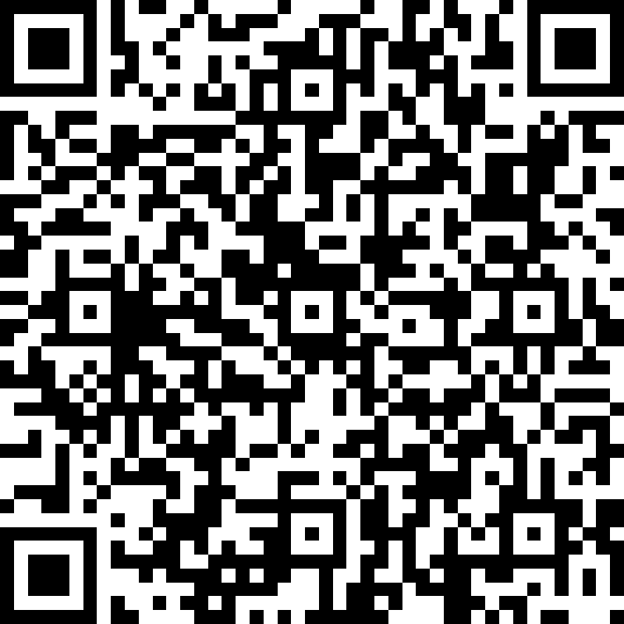
Summer (HAF) Programme 2021
Somers Town Youth Centre/ SCYAP
Summer Holiday Programme (2nd August – 27th August 2021) aged 13 to 19 and up to 25 with SEND
For more information please email or use this QR code to register
Joanne Peet joanne.peet@camden.gov.uk / 07769235260
Tony Edwards anthony.edwards@camden.gov.uk / 07908652288
2nd August
1:00 – 5:00
Outdoor multi-sport fun and games
5:30-8:00
Evening youth work session including healthy cooking, music, arts and games
3rd August
10:45 – 4:00
Go- Karting
5:30 - 8:00
Youth Centre and gardening project @ SCYAP
4th August
10:00 – 3:00
Go-Ape
5:30-8:00
Evening youth work session including healthy cooking, music, arts and games
5th August
11:00 – 4:00
Transition Project
Cinema trip
5:30-8:00
Evening youth work session including healthy cooking, music, arts and games
6th August
1:00 – 5:00
Outdoor multi-sport fun and games
5:30-8:00
Evening youth work session including healthy cooking, music, arts and games

Slide 2
Summer (HAF) Programme 2021
For any information about our programme please email;
Joanne Peet joanne.peet@camden.gov.uk / 07769235260
Tony Edwards anthony.edwards@camden.gov.uk / 07908652288
9th August
11:00 – 3:00
Cookery Project
10:30 – 2:30
Tie – Dye T-Shirt Design
5:30-8:00
Evening youth work session including healthy cooking, music, arts and games
10th August
11:00 – 3:00
Cookery Project
10:30 – 2:30
Tie-Dye
T-Shirt Design
5:30 - 8:00
Youth Centre and gardening project @ SCYAP
11th August
10:30 – 5:00
I-Fly
5:30-8:00
Evening youth work session including healthy cooking, music, arts and games
12th August
12:00 – 4:00
Transaction Project
5:30-8:00
Evening youth work session including healthy cooking, music, arts and games
13th August
9:00 – 6:30
Thorpe Park
5:30-8:00
Evening youth work session including healthy cooking, music, arts and games

Slide 3
Summer (HAF) Programme 2021
Some of the dates/ programmes might be changed. Please contact the team for further information. We will also be providing food and refreshments for those attending
16th August
9:30 – 4:00
Snow Boarding
5:30-8:00
Evening youth work session including healthy cooking, music, arts and games
17th August
1:00– 4:00 Outside sports activities Picnic in
Primrose Hill
3:00 – 4:30
Substance misuse awareness workshop
5:30 - 8:00
Youth Centre and gardening project @ SCYAP
18th August
9:45 – 5:00 Quadbikes (over 16)
5:30-8:00
Evening youth work session including healthy cooking, music, arts and games
19th August
10:30 – 3:00
First Aid course
11:15 – 3:15
Manicure
12:00 – 4:00
Transaction Project
(Bowling)
5:30-8:00
Youth Centre activities
20th August
11:15 – 3:15
Skin care & Facials
1:00 – 5:00
Outdoor multi-sport fun and games
5:30-8:00
Evening youth work session including healthy cooking, music, arts and games

Slide 4
Summer (HAF) Programme 2021
To register please scan the QR code
23rd August
10:30- 3:00
Baking – The perfect chocolate cake
11:00 – 4:00
Golf football
5:30-8:00
Evening youth work session including healthy cooking, music, arts and games
24th August
1:00 – 5:00
Sexual Health/ relationship workshop and fun activities
5:30 - 8:00
Youth Centre and gardening project @ SCYAP
25th August
11:30 – 4:00
Cardrome
5:30-8:00
Evening youth work session including healthy cooking, music, arts and games
26th August
1:00 – 4:00
BBQ - National Burger day (make healthy burgers) music, fun games
5:30-8:00
Evening youth work session including healthy cooking, music, arts and games
27th August
8:30 – 6:30
End of Summer family trip to Southend
5:30-8:00
Evening youth work session including healthy cooking, music, arts and games

Slide 5
